Slide 1

Project 1 – Twitter Sentiments
Ning Ding
David John Chartrand
Haiming Wang
Notes:
Haiming

Slide 2
Agenda
Introduction
Group Members and Tasks
Primary Exploratory Questions
Project Flow
Data Gathering & Manipulation
Visualizations & Findings
Q &A
Notes:
David

Slide 3
Introduction
US Stock Market
Other Stock Markets
Twitter Sentiment Analysis
Notes:
Haiming:
In this project, we are curious in several stock market related topics. While our main focus is to identify any potential correlations between tweets from active financial professionals’ tweets and the stock market fluctuations, we are also interested to uncover any major correlation between the US and Stock Market in other parts of the world. We are looking to gather data through different channels and answer the questions by running sentiment analysis on the data.
ACWV: World market ticker
SPY: US Market

Slide 4
Meet our team
Ning Ding
Scrum, Stock Data & Data Manipulation
David Chartrand
Twitter API
Haiming Wang
Visualization
Notes:
Haiming

Slide 5
Primary Exploratory Questions
Is there a correlation between other stock markets in the world and the US Indexes? Is the distribution of daily return normalized?
Notes:
David

Slide 6
Primary Exploratory Questions
How do a random sample of active influential financial professionals’ tweets correlate to the stock markets? What is the correlation between the tweets and the market?
Notes:
David

Slide 7
Primary Exploratory Questions
Does either positive or negative tweets have a more significant correlation to the market?
Notes:
David

Slide 8
Project Flow
Planning
Data Gathering
Manipulation
Finalize
Visualization
1
2
3
4
5
Notes:
David
Planning
Generate the proposal, division of tasks, timeline management. Confirming our project will be focusing on the correlation between US Stock market and markets in other parts if the world. As well as correlation between the sentiments from influential financial professionals and the stock market movements
Data Gathering
Determine the source of data, if needed specify the APIs we will be using. Determined Data Sources, we are using yfinance to retrieve stock data and Twitter API to obtain data required for sentiment analysis
Manipulation
Writing scripts to clean and sort the data, transform the data to data frame and desired format. Creating branches, Cleaning the data from both sources, removing unnecessary information. Cleaning the data and merging required data frames and getting them ready for further analysis. Creating sentiment analysis functions.
Visualization
Determine the visualizations suitable for the assignment and generate the graphs. Using prepared data to create different visualizations that provides more insights into the results.
Finalize
Summarize and use our results to answer the questions, present the results. Summarize results and present: Putting analysis results together and presenting the findings with visualizations and summary.

Slide 9

Data Gathering & Manipulation
Twitter API
Yahoo Finance
Notes:
David:
Twitter API: Requested API access from the Twitter for developers' page and gained access. Downloaded the tweets from randomized influential finance professionals who are active on tweeter. By pulling the data from Twitter API we were able to retrieve the data content, user ID, and date of the tweets among other information.
Ning:
Yahoo Finance (Yfinance): We located the “yfinance” library on Github which retrieves stock prices and other data from Yahoo Finance, after installing the module, we imported all historical stock prices of the S&P 500 (ticker: SPY) index. We will compare the fluctuations of this index against the tweets at any point in time and hope to identify the correlation between the sentiments of the tweets and the changes in stock prices.

Slide 10
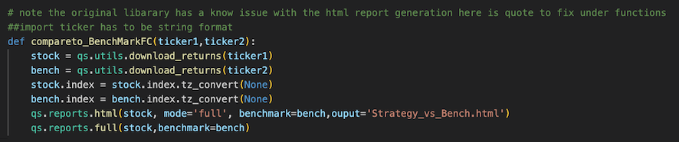

Data Gathering & Manipulation
Data Cleaning, Manipulation and Preparation
Notes:
Ning:
Download data from yfinance for certain stock (SPY & ACWX in this case) using its ticker (SPY, ACWX).
Putting data into Data Frames using pandas, clean the data by drop any meaningless values and columns. Define functions to trim the data by timeframe to a desired time period.
Build and amend from the available sentiment analysis tools found online, input the twitter data (tweets) gathered with Twitter API, generate sentiment score.
Convert the Twitter sentiment analysis results to pandas Data Frame and prepare for further visualization and analysis.

Slide 11
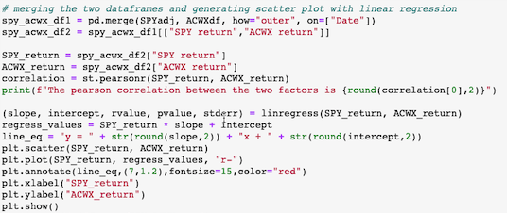
Visualization
Notes:
Haiming
Merge the data frames created for both world market index and US market index to create one combined data frame. Create scatter plot and linear regression to show the relationship between world market index (ACWX) and US Market index (SPY).
Using yfinance’s built-in plotting functions to show the return over of the two stock indexes over the years.
Merge the data frames created for US market index (SPY) and sentiment analysis to create one combined data frame. Create scatter plot and linear regression to show the relationship between sentiment analysis results and US Market index (SPY).
For a certain time frame, compare the US market index return movement against sentiment analysis by plotting a hvplot.

Slide 12
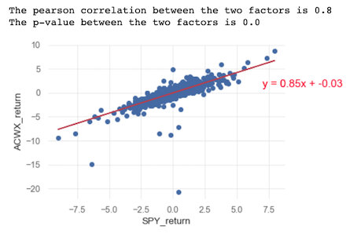
Conclusions & Findings (Visualization)
Linear Regression & Scatter Plot: ACWX Return vs SPY Return:
Notes:
Part I: Discover the Correlation between US Market and other Stock Markets:
In the trend graph, it was difficult to observe any correlation between the two indexes as ACWX was incepted only in 2008 and its average return moves in a overall lower range.
Using scatter plot and linear regression we created, it shows the Pearson correlation coefficient between world market index and US Market Index is 0.8, implying a strong positive correlation between the two indexes.
The result shows that the two index are positively correlated, the movement in the US stock market affects the movements of other markets in the world.

Slide 13
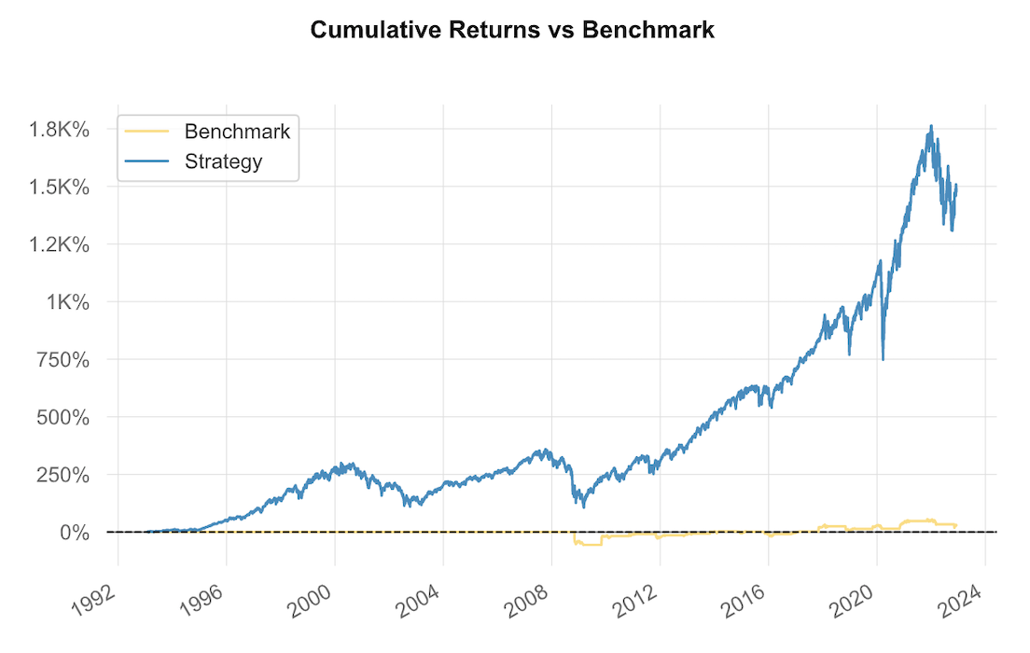
Conclusions & Findings (Visualization)
ACWX Return Movement(Benchmark) vs SPY Return Movement (Strategy):
Notes:
Ning

Slide 14
Conclusions & Findings (Visualization)
Distribution of SPY Return:
Notes:
Ning

Slide 15
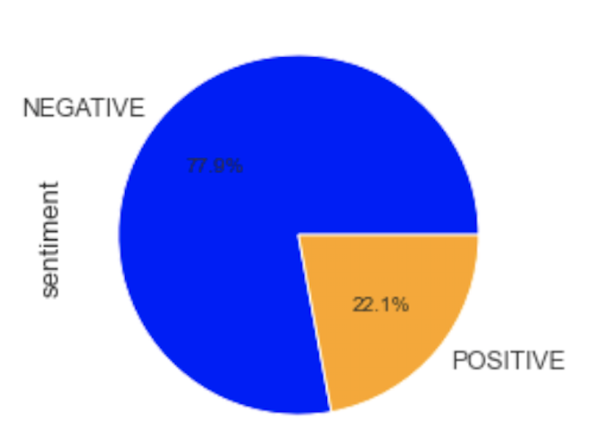
Conclusions & Findings (Visualization)
Pie Chart: Showing the Percentage of Negative Tweets vs Positive Tweets:

Slide 16
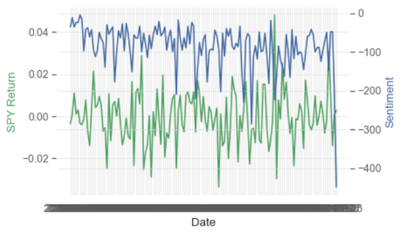
Conclusions & Findings (Visualization)
Hvplot and Subplots: Twitter Sentiment Analysis Result vs SPY Return:
Notes:
David:
Part II: Discover the Effects of Tweets on Stock Markets:
In the hvplot, we are not able to identify any direct relationship between the sentiment analysis results and the return of SPY.
Using scatter plot and linear regression we created, it shows the Pearson correlation coefficient between sentiment analysis and US Market Index is -0.02, implying a very weak positive correlation between the two factors.
The linear regression model result shows that the sentiment and the stock market have very weak correlations, this results shows that the tweets have little to no influence to the stock market fluctuations.

Slide 17
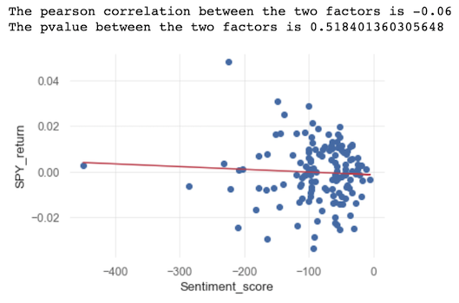
Conclusions & Findings (Visualization)
Linear Regression & Scatter Plot: Twitter Sentiment Analysis Result vs SPY Return:
Notes:
David
Part II: Discover the Effects of Tweets on Stock Markets:
Using scatter plot and linear regression we created, it shows the Pearson correlation coefficient between sentiment analysis and US Market Index is -0.06 and p value is 0.5184, based on the correlation coefficient and p value, implying a very weak positive correlation between the two factors.
The linear regression model result shows that the sentiment and the stock market have very weak correlations, this results shows that the tweets have little to no influence to the stock market fluctuations.

Slide 18
Thank you
Ning Ding
David John Chartrand
Haiming Wang

Slide 19
Q & A

